Slide 1
BCA 6th Semester
Project II (CAPJ356) Orientation
Presented By:
Nabaraj Bahadur Negi | NCCS

Slide 2
Objective
The general objectives of this project work are to make student able in implementing concepts learnt by sixth semester so that they will be able to develop applications of their own choice.
By the end of the project, students will be able to:
Lead a software project development (planning, execution, delivery).
Use CASE tools for modeling, design, and documentation
Implement algorithms to solve problems
Write programs and improve programming skill
Write test cases for software testing and improve QA skill
Improve problem solving skill
Improve report writing kill
Improve presentation skill

Slide 3
Nature of Project
This academic project focuses on the development of computer applications, preferably undertaken individually (though groups of two are allowed with clear justification of individual contributions).
Students are encouraged to build web, mobile, or desktop-based applications using programming languages and technologies they are comfortable with, including those learned up to the sixth semester and beyond.
Projects should:
Incorporate database operations and sophisticated algorithms.
Use appropriate CASE tools.
Prioritize self-developed modules over APIs or plugins (except when unavoidable).

Slide 4
Include reporting and advanced features such as decision-making, business intelligence, or statistical analysis, going beyond simple CRUD operations.
Demonstrate greater complexity than the fourth-semester project.
Be supported by a comprehensive literature review with references to relevant papers.
Potential project domains include web applications, information systems, e-commerce portals, and game applications.

Slide 5
Evaluation Scheme /Marks Distribution
First Stage – Proposal Defense (10%)
-Based on project proposal and presentation.
Second Stage – Main Work (70%)
Work done (50%): system analysis & design, implementation, problem-solving, understanding methods, and effort.
Documentation (20%): report structure, writing quality, completeness, readability, data/results analysis.
Third Stage – Viva-voce (20%)
-Based on presentation, project demonstration, and viva.
-Each student must present and demonstrate a working project.

Slide 6
Evaluators
HOD/ Coordinator
Project Supervisor
Internal Examiner
External Examiner

Slide 7
Prepare Proposal
Introduction
Problem Statement
Objective
Methodology
4.1 Requirement Identification
4.1.1 Study of Existing System
4.1.2 Literature Review
4.1.3 Requirement Analysis
4.2 Feasibility Study 4.2.1 Technical
4.2.2 Operational
4.2.3 Economic
4.3 High-Level Design of System 4.3.1 Methodology of the Proposed System
4.3.2 Flow Chart
4.3.3 Working Mechanism of Proposed System
4.3.4 Description of Algorithms
Gantt Chart (showing the project timeline)
Expected outcome
References

Slide 8
Recommended Project Report Structure
Cover and Title page
Supervisor's Certificate/ Recommendation
Letter of approval / Internal, External Examiners' Approval
Acknowledgement
Abstract
Table of contents
List of abbreviations, list of figures, list of tables
Main report (details below)
References
Bibliography (if any)
Appendices (screen shots, source code, supervisors visit log sheet)

Slide 9
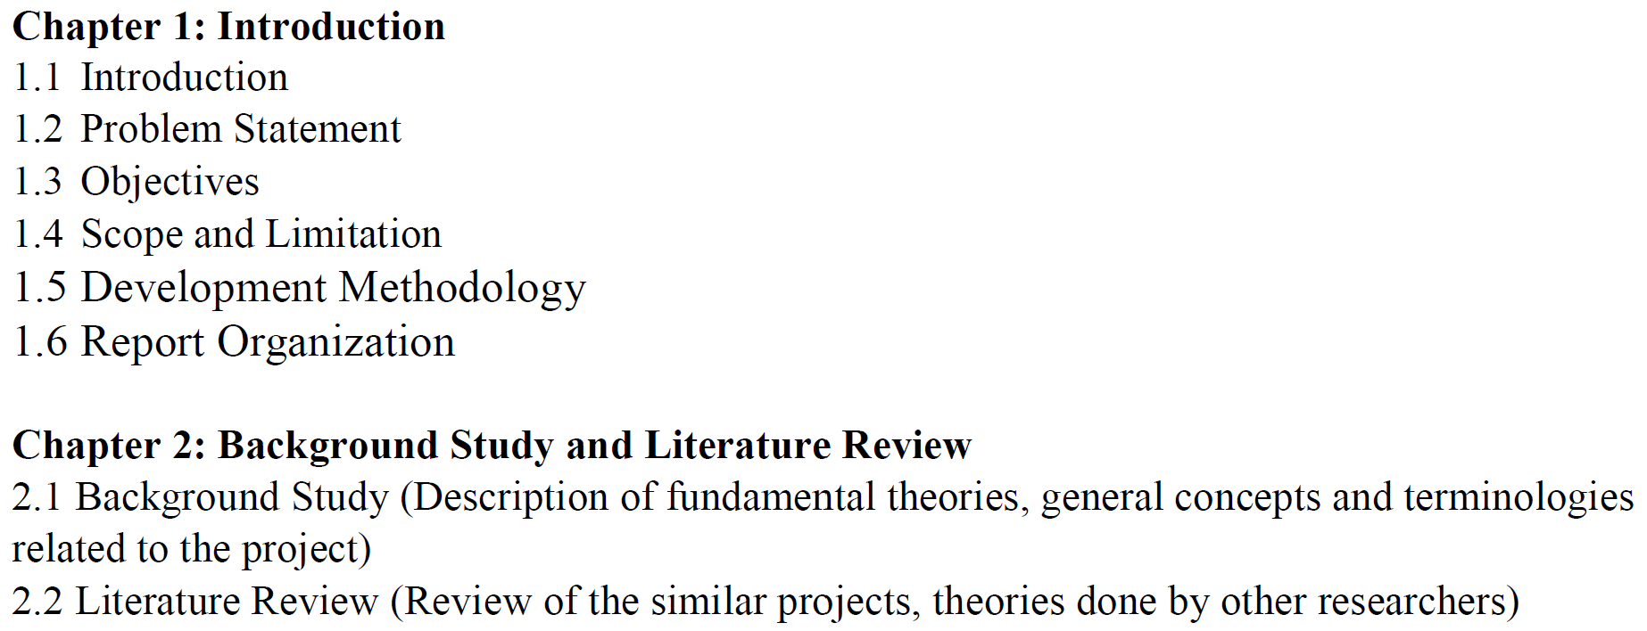
Final Report (Main report ) Structure

Slide 10
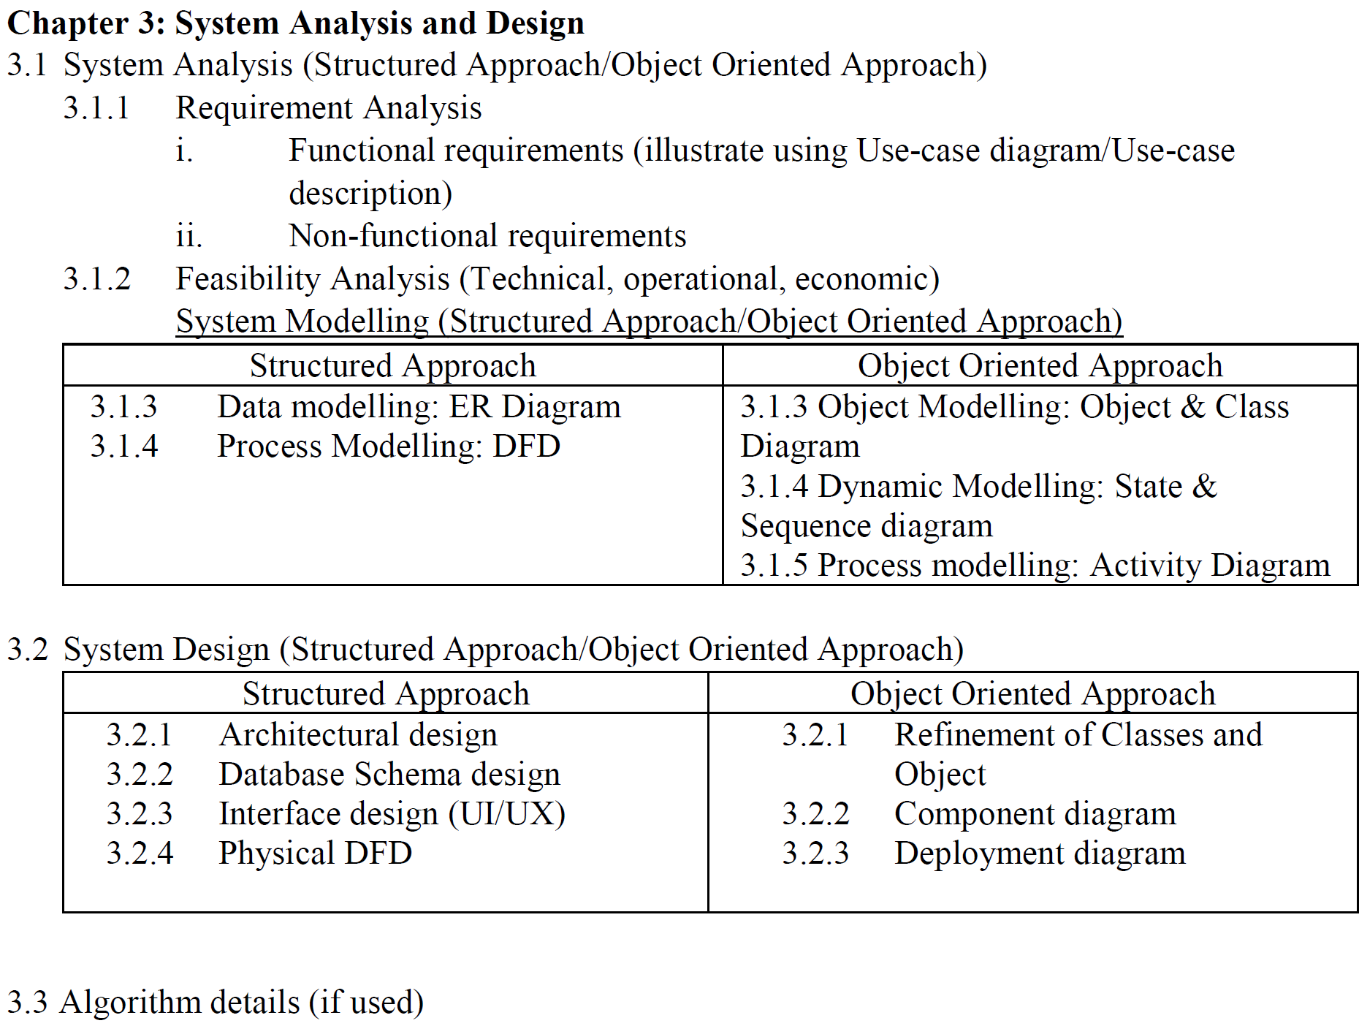

Slide 11
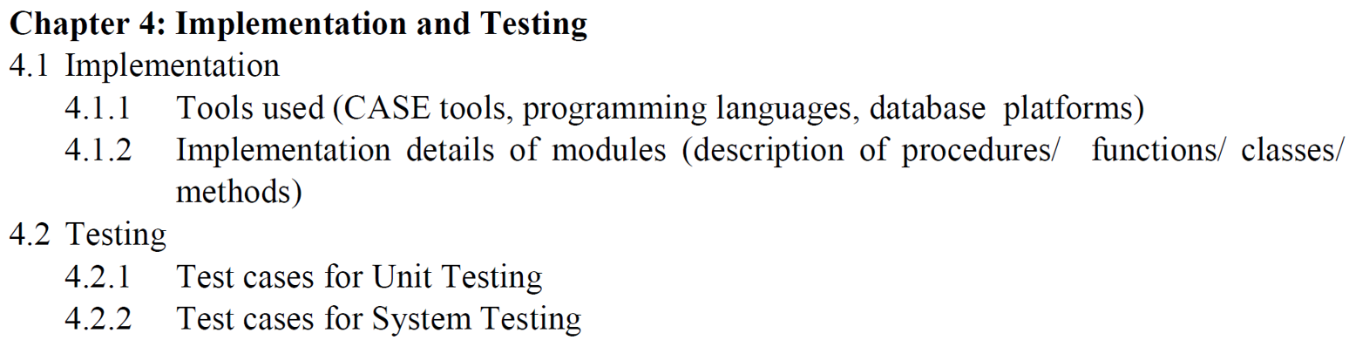
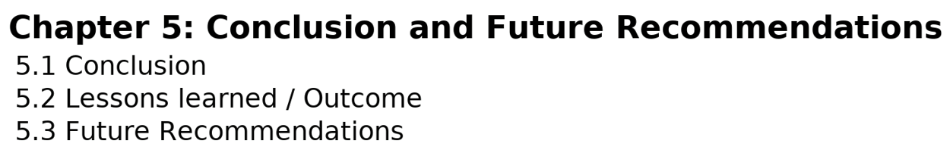

Slide 12
Citation and Referencing
References Section – Include all sources cited in the text (books, articles, URLs, etc.).
Bibliography Section – Include sources consulted but not cited.
Standard – Use IEEE Referencing Style for both in-text citations and reference listing.
Guideline Resource – Full IEEE style details are available at www.ieee.org.

Slide 13
Citation and References: IEEE
Use numbers in square brackets in order of appearance.
Citation
Operating systems manage hardware resources [1].
Several methods are discussed in [2], [3].
References
Book
[1] A. Silberschatz, P. B. Galvin, and G. Gagne, Operating System Concepts, 9th ed. Hoboken, NJ, USA: Wiley, 2012.
Journal Article
[2] J. Smith and R. Brown, “Scheduling algorithms in cloud computing,” IEEE Trans. Cloud Comput., vol. 7, no. 3, pp. 450–462, Jul.–Sep. 2019.
Conference Paper
[3] K. Sharma and M. Singh, “Efficient memory management in real-time systems,” in Proc. IEEE Int. Conf. Comput. Sci. Eng., Kathmandu, Nepal, 2020, pp. 120–125.
Website
[4] IEEE, “Author digital toolbox,” [Online]. Available: https://www.ieee.org/publications/authors/author-digital-toolbox.html. [Accessed: Sep. 2, 2025].

Slide 14
Report Format Standards
Page Numbering
Preliminary pages (certificate to lists)-Roman numerals (i, ii, iii…).
Main text (from Chapter 1)-Arabic numerals (1, 2, 3…).
Placement - Bottom center.
Page Setup
Paper size: A4.
Margins: Top = 1", Bottom = 1", Right = 1", Left = 1.25".
Paragraphs
Alignment: Justified.
Line spacing: 1.5.
Font
Style: Times New Roman.
Size: 12 pt for main text.
Section Headings
Chapter title: 16 pt, bold.
Section heading: 14 pt, bold.
Sub-section heading: 12 pt, bold.
6. Figures & Tables
Alignment: Centered.
Captions: Bold, 12 pt.
Figure (Caption below)
Table (Caption above)

Slide 15
Algorithms to Implement in Project II
Sorting & Searching
Bubble, Insertion, Selection, Merge, Quick, Heap, Counting/Radix
Linear Search, Binary Search, Interpolation Search, Exponential Search
Core Data Structures
Singly/Doubly Linked List, Stack, Queue, Deque
Hash Table
Heap / Priority Queue (min/max)
Trie (Prefix Tree)
Trees
Binary Search Tree (BST)
Balanced trees: AVL, Red–Black
B-Tree / B+ Tree (DB-style indexes)
Segment Tree / Fenwick Tree (BIT)
Graph Algorithms
BFS, DFS, Topological Sort
Dijkstra, Bellman–Ford, Floyd–Warshall, Johnson
A* Search
Kruskal, Prim (Minimum Spanning Tree)
Bipartite Check, Bridges & Articulation Points
Max-Flow/Min-Cut (Edmonds–Karp or Dinic)
Hungarian Algorithm (assignment)

Slide 16
Machine Learning & Recommenders (if your project is data-driven)
K-Nearest Neighbors (KNN), Linear/Logistic Regression
Naïve Bayes, Decision Tree, Random Forest, SVM
K-Means, DBSCAN, PCA
Collaborative Filtering (user/item-based), Content-Based, Hybrid
Matrix Factorization (SVD/ALS)
AI Search & Heuristics (games/robotics/optimization)
Greedy Best-First, IDA*
Minimax with Alpha–Beta Pruning
Genetic Algorithms, Simulated Annealing, Tabu Search
Systems, security & distributed
AES / RSA / Diffie–Hellman / SHA-256
Consistent Hashing
CRC / Hamming

Slide 17
Some Project Topics
Online Job Portal with Skill Matching
Event Management and Ticket Booking App
Traffic Management System
AI-Based Crop Disease Detection
Disaster Alert and Rescue App
Farm Management Game
Fake News Detection System using Natural Language Processing
AI-Powered Chatbot for Customer Support using Natural Language Processing and Decision Tree Algorithm
Online Food Delivery System using Genetic Algorithm and Shortest Path Optimization
Blockchain-Based Voting System using SHA-256 and Consensus Algorithms
E-Learning Platform with AI Tutor using Collaborative Filtering and Neural Networks
Inventory Management System using Predictive Analytics and Queue Management Algorithms
Crowdfunding Platform for Students using Blockchain and Recommendation Algorithms

Slide 18
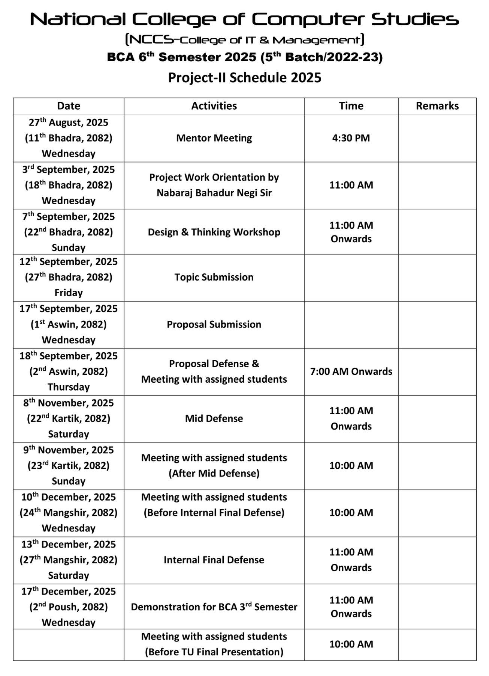

Slide 19
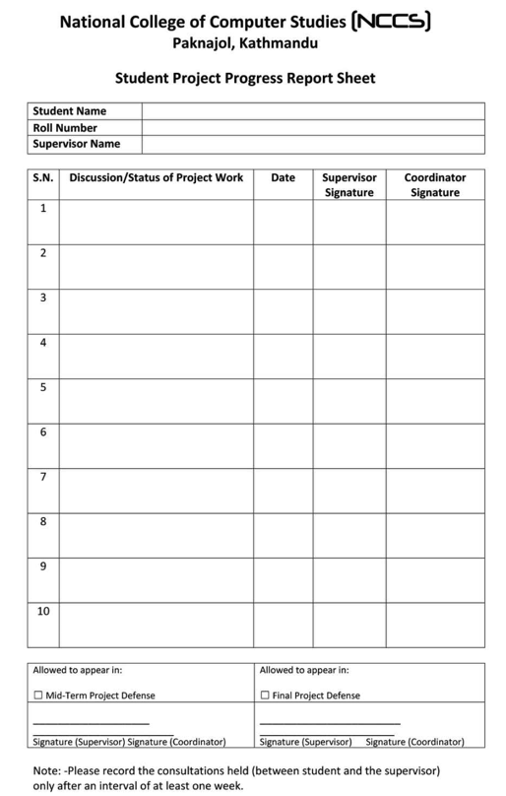

Slide 20
Thank You

